Slide 1
Notes to Instructor
Material Needed
  Hard copies of the SDTM IG V3.2 printed out and bound for each participant
  Post-it Note Flags (rectangular and colored on one end) – each participant will need about 2-3 packs of these (~50 or so flags per person)
  Colored paper for simulation
  Each participant will need to bring their laptop to access workshop templates needed to complete workshop exercises
  Excel file Exercise Templates and additional electronic resources (can be e-mailed ahead of time)

Slide 2
Electronic Documents Required
Lilly Lilly Workshop Mod3.pptx (this power point)
Participants will need the following for exercises:
  Lilly Mod 3 Exercise.xlsx

Slide 3
Lilly Workshop Module 3
Mapping the Protocol to Trial Design Data Sets

Slide 4
Objectives
Provide an overview of Trial Design Domains
  Participants will understand the purpose of each
Participants will understand the meaning and usage of Arms, Elements and Epochs
  Participants will represent these timing divisions in a simulation
Participants will be able to create Trial Arms (TA) and Trial Elements (TE) Domains

Slide 5
Trial Design Model Overview

Slide 6
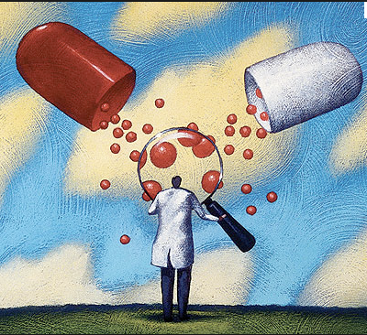
Trial Design Model (TDM)
What is it?
A standardized model to describe the planned design of trial
  Industry standard to use a template
  Manual
  End Result the Trial Design data sets
Representation of the study/protocol in machine-readable, searchable format (i.e. data sets)
The trial design domains do not contain subject-level data
  This means no actuals!
Notes:
Captures protocol information

Slide 7

Trial Design Model (TDM)
Why is it important?
It is a required part of CDISC compliant data submissions to the FDA
Helpful in quickly grasping the overall design and timing divisions of a study in a standardized way
  Speeds FDA review
Used as an input to subject level SDTM (and ADaM) data sets
  Subject Elements (SE) – Planned and unplanned subject-level trial elements
  Subject Visits (SV) – Planned and unplanned subject-level trial visits
  Planned and actual treatment groups in ADSL

Slide 8
Trial Design Model (TDM)
What are the domains?
Experimental Design: TA and TE
Scheduling of Assessments: TV and TD
Trial Arms (TA)
Trial Elements (TE)
Trial Visits (TV)
Trial Summary and Eligibility: TI and TS
Trial Disease Assessments (TD) (New per SDTM IG 3.2)
Trial Inclusion/Exclusion Criteria (TI)
Trial Summary Information

Slide 9
Experimental Design: TA and TE
Trial Elements (TE)
  Elements are the time/activity segments that collectively describe the conduct of the trial
  Generic definition for each Element is in TE
  “building blocks” or “stepping stones”
Element Examples
  Screening element
  Run-in element
  Treatment X element
Trial Arms (TA)
  Describes each planned Arm in the trial
  Arms are the experimental units of comparison within the trial
  TA assembles the Elements used for a specific Arm (its time-course)
ARM Examples
  Placebo group
  Active Comparator group
  Treatment A group
  Fun group
  Polka Dots Only group

Slide 10
Scheduling of Assessments: TV and TD
Trial Visits (TV)
  Defines the visit schedule per the protocol (planned visits only)
  Must match VISIT/ VISITNUM values in the SDTM datasets (unless unplanned visits)
Trial Disease Assessment (TD)
Lists the planned disease assessment schedule per the protocol
Developed specifically for RECIST, makes it possible to do an assessment time bias evaluation
Do not create TD if disease assessment schedule may vary for individual subjects
Treatment 1
Treatment 2
Tumor Assessment Every 8 Weeks
Tumor Assessment Every 12 Weeks
DOMAIN | VISITNUM | TVSTRL
TV | 1 | Start of screening
TV | 2 | Day of first dose
TV | 3 | 1 week after first dose
Notes:
TD captures planned assessments per the protocol. This domain was developed specifically with RECIST in mind, and makes possible an evaluation of assessment time bias.
Example TD: Disease assessments that per the protocol occur every 8 weeks during Treatment 1, and every 12 weeks during treatment 2.
What is RECIST?
Response Evaluation Criteria In Solid Tumors (RECIST) is a set of published rules that define when tumors in cancer patients improve ("respond"), stay the same ("stabilize"), or worsen ("progress") during treatment.

Slide 11
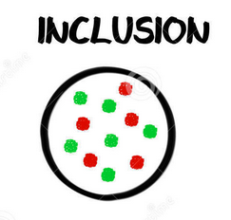
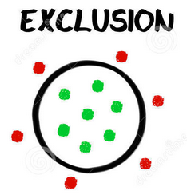
Trial Summary and Eligibility: TI
TI:
  Full list of criteria from protocol
  Must match IETEST/IETESTCDs in IE
  If criteria > 200 characters, edit to fit
  If an amendment changes a criteria, create a whole new set (version variable distinguishes them)
Notes:
Don’t confuse with IE (inclusion/exclusion criteria not meet) which is a Findings Domain

Slide 12
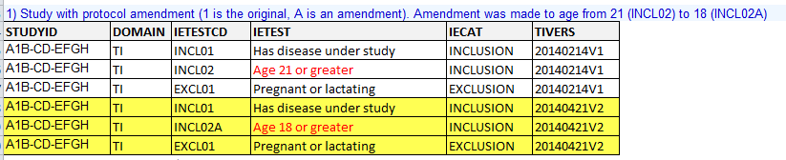
Trial Summary and Eligibility: TI Data Example

Slide 13

Trial Summary and Eligibility: TS
TS:
  Key descriptors of the trial
  Brief synopsis of the trial – helps reviewers
  Most items aligned with fields in clinicaltrials.gov
  Contains other information not in other datasets
    Null flavors
      Explain why a value is missing
    Name of terminology set
    Value codes
  Certain values come from specific industry lists
    TRT from UNII
    PCLAS from NDF-RT
Notes:
UNII = FDA’s Unique Ingredient Identifier
NDF-RT = National Drug File – Reference Terminology

Slide 14
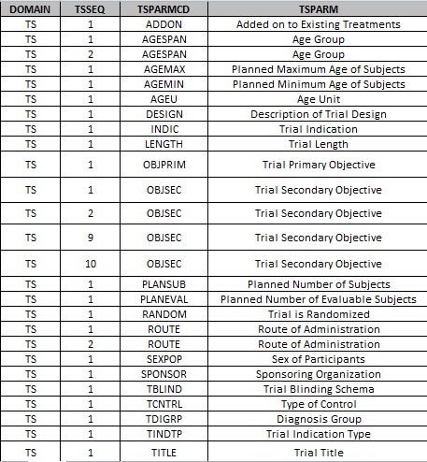
Trial Summary and Eligibility: TS Data Example
TSSEQ
TSSEQ is by default set to a value of “1”. If there is more than one category of a given TSPARM (e.g. secondary objectives, age group), two steps need to occur.
If there is only one category of TSPARM (e.g. trial title) then the default value of “1” is left as is.

Slide 15
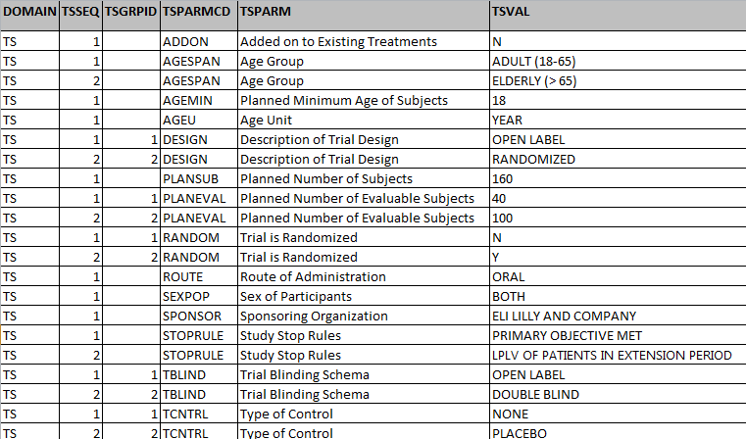
Trial Summary and Eligibility: TS Data Example (Oncology Example with 2 Parts)
TSGRPID
Used to tie together a group of related records
Use only if your trial has multiple parts and you need to distinguish the summary parameters from each other
Notes:
Otherwise TSGRPID should be left blank

Slide 16
Closer Look at Arms, Elements, & Epochs in Trial Design

Slide 17

CDISC Timing Divisions
The Problem…
  Legacy timing divisions (e.g. Periods, Segments, Phases, etc.) are inherently meaningless because they mean different things in different companies, therapeutic areas and regions
    Oncology versus Diabetes versus everybody else
    Merck versus Lilly versus Pfizer versus everybody else
    UK versus US versus ROW
The Solution…
  CDISC addressed this issue by creating new words that have no inherent meaning and assigned definitions to them
Notes:
ROW = the rest of the world

Slide 18
Basic definition: Epoch and Element
The primary timing divisions (called EPOCHs) are composed of secondary timing divisions (called ELEMENTs)
  There are no timing gaps – all of a subject’s experience between screening and final conclusion falls into some EPOCH and ELEMENT
The classification and naming of a timing division into EPOCHs or ELEMENTs and the granularity of those assignments is sponsor-specific
Notes:
Elements can be repeated
EPOCHs are not

Slide 19
Basic definition: Epoch and Element
EPOCHs are typically such things as
  Screening period
  Treatment period
  Follow-up period
  etc.
ELEMENTs are typically such things as
  Drug X treatment
  Placebo
  Washout
  Run In
  etc.
Remember that the granularity is sponsor-specific!
  One sponsor’s ELEMENT may be another sponsor’s EPOCH
Notes:
Elements can be repeated
EPOCHs are not

Slide 20
Basic definition: Epoch and Element
“The variable EPOCH should be included for clinical subject-level observation (e.g., adverse events, laboratory, concomitant medications, exposure, vital signs). This will allow the reviewer to easily determine during which phase of the trial the observation occurred (e.g., screening, on-therapy, follow-up), as well as the actual intervention the subject experienced during that phase.“
  FDA Study Data Technical Conformance Guide

Slide 21
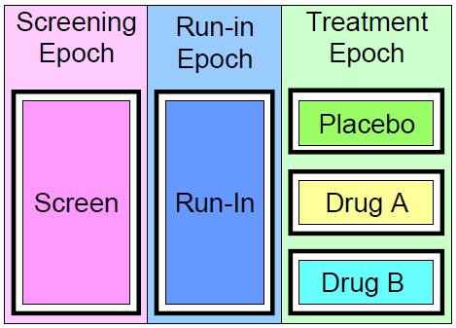
Trial Elements (TE)
“What are the different ‘time/activity’ segments that make up the trial?”
Elements are the building blocks for the trial

Slide 22





Trial Elements (TE)
In TE, elements are independent of how they are used
  Can be reused when you define Arms

Slide 23
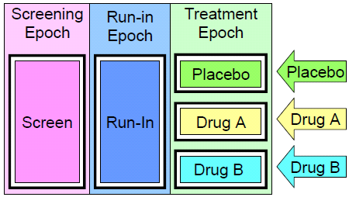
Trial Arms (TA)
“For Treatment Group X, what does the conduct of the trial look like?”
Or “what is the path (“stepping stones”) the patient will take?”

Slide 24
Metadata: TA and TE
TA Variable Name | TA Label
STUDYID | Study Identifier
DOMAIN | Domain Abbreviation
ARMCD | Planned Arm Code
ARM | Description of Arm
TAETORD | Planned Order of Element within Arm
ETCD | Element Code
ELEMENT | Description of Element
TABRANCH | Branch
TATRANS | Transition Rule
EPOCH | Epoch
TE Variable Name | TE Label
STUDYID | Study Identifier
DOMAIN | Domain Abbreviation
ETCD | Element Code
ELEMENT | Description of Element
TESTRL | Rule for Start of Element
TEENRL | Rule for End of Element
TEDUR | Planned Duration of Element

Slide 25

Simulation: “A Day In the Life…”
Assumptions
  Equating a planned day from individuals’ calendars to a clinical trial
  Selected trainees will help to demonstrate trial design concepts
  Please keep your assigned “card” facing the classroom audience

Slide 26
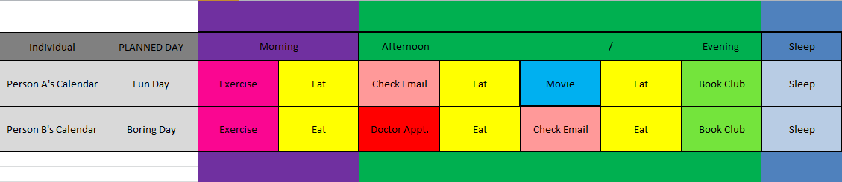
Simulation: “A Day In the Life…”
“Calendar”

Slide 27
Simulation of Person B’s “Boring” Day
Planned “activities”

Slide 28
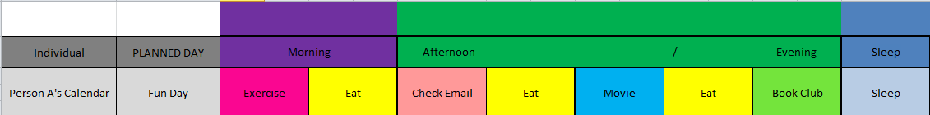
Simulation of Person A’s “Fun” Day
Planned “activities”
Oops! Person A sustained an injury during exercise!

Slide 29


Person A: What Really Happened?
Should person A update their “calendar”?
Would this change in activities get documented in the SDTM trial design model?

Slide 30
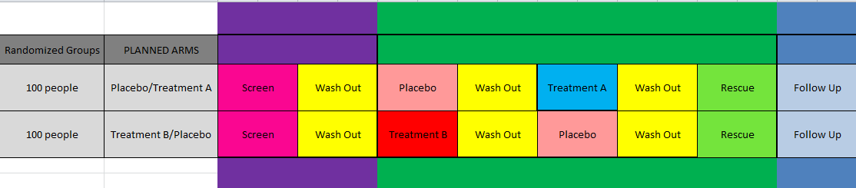
The “Flipside”
How could the “day in the life” analogy correlate to a real study design?
Flip your “card”
What does the Purple, Green and Dark Blue represent?
What could we (the sponsor) name these periods of time?

Slide 31
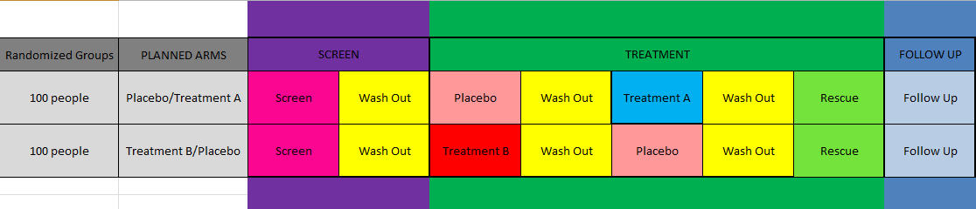
Possible EPOCH Names
Could the TREATMENT EPOCH be segmented differently?

Slide 32

Planned vs. Actual
Planned
Goes in TE and TA as is!!!
Actual
Goes SE

Slide 33
End of Simulation

Slide 34
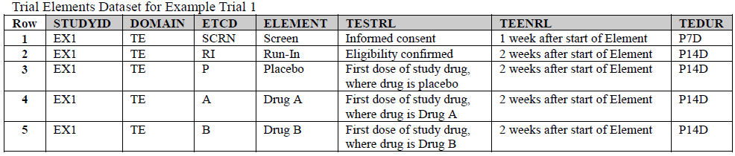
Data: Trial Elements (TE)
One or the other, not both
Notes:
The IG allows both TEENRL and TEDUR to be populated but this is unnecessary, causes confusion and is generally bad practice. Notice how in the example (from the IG) the two are restatements of the same thing; it doesn’t add value to populate both.

Slide 35
Data: Trial Elements (TE)
Practical Considerations for Start Rules
  Rules are used when populating SESTDTC in SE
  Should be easily translatable to programming instructions
  Should relate to variables/values found in the data

Slide 36
Data: Trial Elements (TE)
ELEMENT=FOLLOW-UP
  Weak Example: “2 days after treatment ends” (How do we assess that?)
  Better Example: “First assessment when VISIT=FU” (Easy to find in the data)

Slide 37
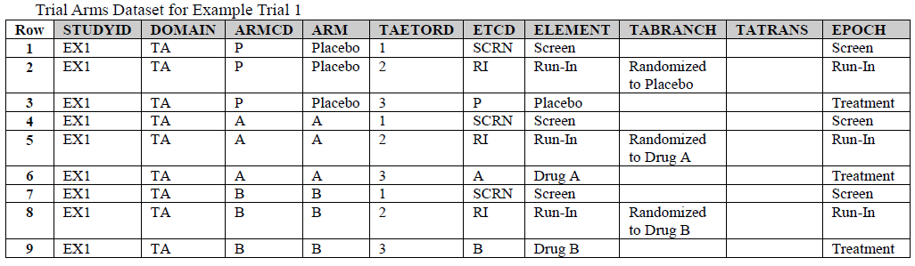
Data: Trial Arms (TA)

Slide 38
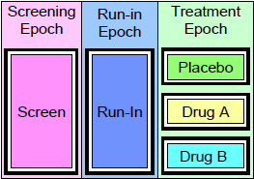
Parallel Trial Design Example
ARM=P
ARM=A
ARM=B
Remember:
EPOCHs are composed of ELEMENTs
The specific sequence of ELEMENTs/EPOCHs is what defines ARMs

Slide 39
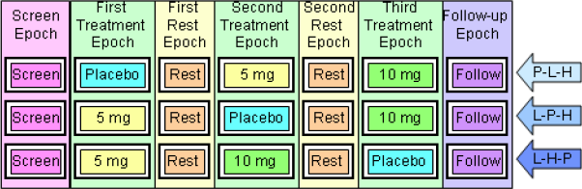
Crossover Trial Design Example
The TDM scheme accommodates complexity
Have we seen a cross over design before?

Slide 40
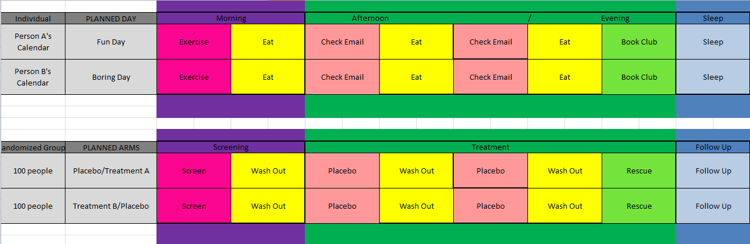
Back to the Simulated Trial…
Placebo ARM?
What would it look like?

Slide 41
Lilly Module 3 Exercise #1
Create Trial Design Data Sets TA and TE

Slide 42
Fact Check…
What is an ELEMENT?
  The lowest level time division for a trial
  The basic building-block for a trial
What is an EPOCH?
  A high level time division for a trial
  EPOCHs are composed of one or more ELEMENTs
What is an ARM?
  The experimental units of comparison within the trial
  Described in TA by the timing/activities prescribed for subjects within that group (“path” or “patient’s journey”)

Slide 43
Lilly Mod 3 Exercise #1
Use “Lilly Mod 3 Exercise” template
  Lilly Mod 3 Ex. 1 TE tab
  Lilly Mod 3 Ex. 1 TA tab
Use SDTM IG TA and TE (hard copy) as a resource
Create a Trial Arm (TA) data set and a Trial Element (TE) data set based on the Study Design, SDTM IG, and the Template provided

Slide 44
Study Design
Per the protocol, there are three different Epochs (major timing segments) in this Study Design
In addition, the treatment phase has two parts
Placebo
Washout
Screen
Follow-Up
Drug X
Washout
Screening Phase 1 Phase 2 Follow-up
up to 2 weeks 21 days 21 days 3 months

Slide 45
Create TA and TE Data Sets
Add post-it tabs to TA and TE pages in SDTM IG
Complete the TA and TE Templates
BONUS: Fill in TABRANCH
TE
STUDYID | DOMAIN | ETCD | ELEMENT | TESTRL | TEDUR
TA
STUDYID | DOMAIN | ARMCD | ARM | TAETORD | ETCD | ELEMENT | TABRANCH | EPOCH

Slide 46
Hints / Reminders
Per the protocol, there are three different Epochs (major timing segments) in this Study Design
In addition, the treatment phase has two parts
Placebo
Washout
Screen
Follow-Up
Drug X
Washout
Screening Phase 1 Phase 2 Follow-up
up to 2 weeks 21 days 21 days 3 months

Slide 47
Possible Answer - TE
Answers may vary depending on Study-Level Terminology and interpretation of the protocol
STUDYID | DOMAIN | ETCD | ELEMENT | TESTRL | TEDUR
XYZ123 | TE | SCRN | Screen | Informed Consent Signed | P2W
XYZ123 | TE | WO | Washout | End of dosing | P21D
XYZ123 | TE | X | Treatment X | First Dose of Drug X | P21D
XYZ123 | TE | PBO | Placebo | First Dose of Placebo | P21D
XYZ123 | TE | FU | Follow-Up | First assessment of first follow-up visit | P3M

Slide 48
Possible Answer - TA
Answers may vary depending on Study-Level Terminology and interpretation of the protocol. Note that EPOCH has CDISC terminology which must be used!
STUDYID | DOMAIN | ARMCD | ARM | TAETORD | ETCD | ELEMENT | TABRANCH | EPOCH
XYZ123 | TA | X | Drug X | 1 | SCRN | Screening | Randomized to X | SCREENING
XYZ123 | TA | X | Drug X | 2 | A | Treatment X |  | TREATMENT
XYZ123 | TA | X | Drug X | 3 | WO | Washout |  | TREATMENT
XYZ123 | TA | X | Drug X | 4 | FU | Follow-Up |  | FOLLOW-UP
XYZ123 | TA | PBO | Placebo | 1 | SCRN | Screening | Randomized to Placebo | SCREENING
XYZ123 | TA | PBO | Placebo | 2 | PBO | Placebo |  | TREATMENT
XYZ123 | TA | PBO | Placebo | 3 | WO | Washout |  | TREATMENT
XYZ123 | TA | PBO | Placebo | 4 | FU | Follow-Up |  | FOLLOW-UP

Slide 49
Subject Elements (SE)
ETCD/ELEMENTs and date/times for each subject
Includes planned and unplanned
Elements are continuous throughout study
The end of one element is the beginning of the next
NO GAPS
Planned ETCD/ELEMENT values must match TE

Slide 50
Subject Elements (SE)
Population of SE requires study-specific programming
Start rules are in TE
Element start points are usually based on info in EX and DS
Once SE is created, it is easy to populate EPOCH
EPOCH is requested/expected by FDA
SE will be covered in more detail in a later training module

Slide 51
Summary
The Trial Design datasets represent a clinical protocol in dataset format
Trial Design domains capture the overall plan and design of a clinical study.
  TA/TE: Experimental Design
  TV/TD: Assessment Schedule
  TS/TI: Summary and Eligibility
FDA wants “EPOCH” in subject-level datasets
  This is facilitated by the creation of TE and SE
Resources and References
  Lilly’s TDM template
  PharmaSUG (2014)Paper “Considerations in Creating SDTM Trial Design Datasets”

Slide 52
End of Lilly Module 3 ☺

